Slide 1



Exoskeleton IoT for remote monitoring and control
MA1 Project
Promoter: Prof. Vanderborght
Co-promoter: Prof. Lefeber
Supervisor: Dr. Ir. Grosu
Julien van Delft

Slide 2

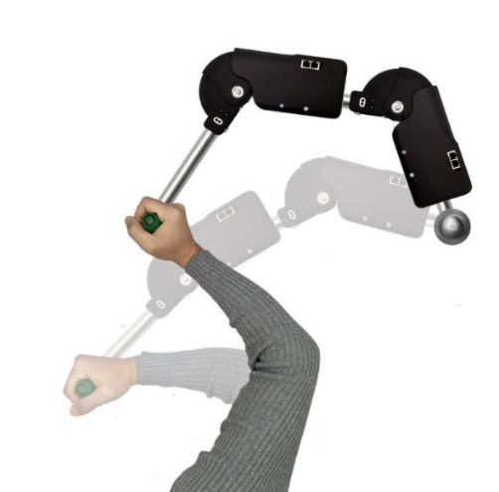




Project description
EtherCAT
Main computer Matlab/Simulink
Interactive game front end
Mechanical system
IoT enabling (4G/5G)
Interactive gaming back end

Slide 3
Objectives
Reliable communication between exoskeleton and server
Doctor can monitor incoming data from exoskeleton
Doctor can send data to the exoskeleton

Slide 4
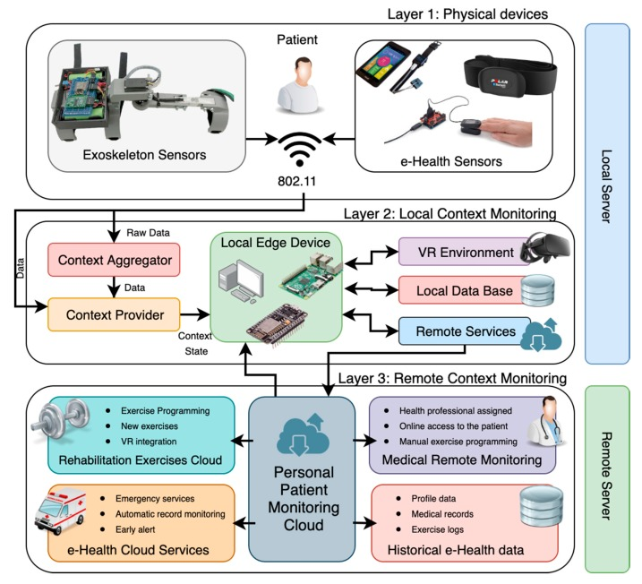

Similar projects
Study on rehabilitation exoskeleton based on virtual reality
BICS Cellular connected IoT exoskeleton
(Daniel H de la Iglesia et al., 2020)

Slide 5
Requirements
The exoskeleton contains 6 sensors sending 16 bits every ms
96 kbps as reference
Requirements
At least 96 kbps
Wearable suited
Large coverage
Small delay
Small cost
Available in Belgium

Slide 6
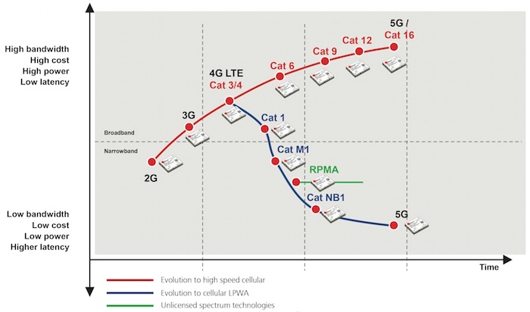
Mobile technology
Slow evolution from ‘90s with 15 Kbps
to nowadays 5G with 10 Gbps
Latency as low as 1ms
New LPWAN IoT oriented
- LTE-M
- NB-IoT
 | NB-IoT | 4G | LTE-M
Latency | -- | ++ | ++
Data rate | -- | ++ | +
Power efficient | ++ | -- | +
Mobility | -- | ++ | ++
Available | ++ | ++ | -
(u-blox, 2018)
4G

Slide 7
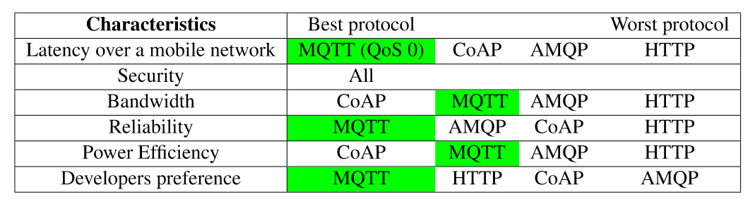
Communication protocol
4 Protocols compared:
Publish-subscribe: MQTT and AMQP
Request-response: CoAP and HTTP
MQTT

Slide 8
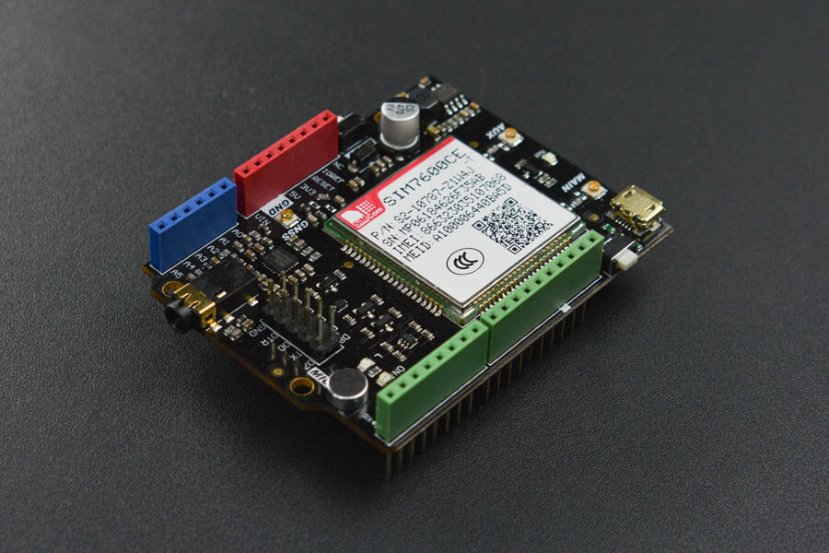
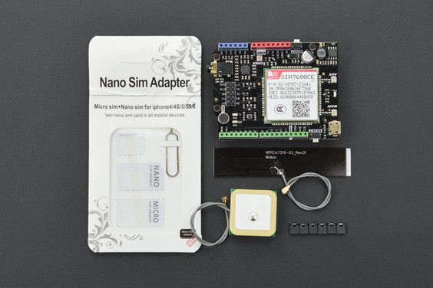
Chosen module
DFRobot SIM7600 Arduino shield
Easy Matlab implementation and coding
Arduino shield preferred
(DFRobot)

Slide 9
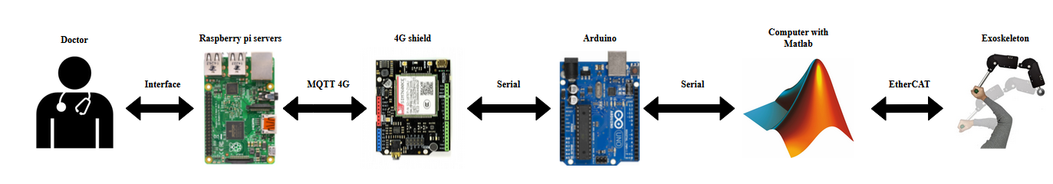
Project architecture
Easy data exchange between exoskeleton and doctor

Slide 10
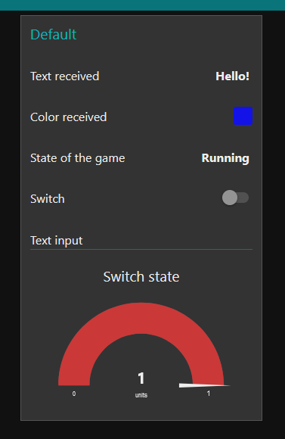
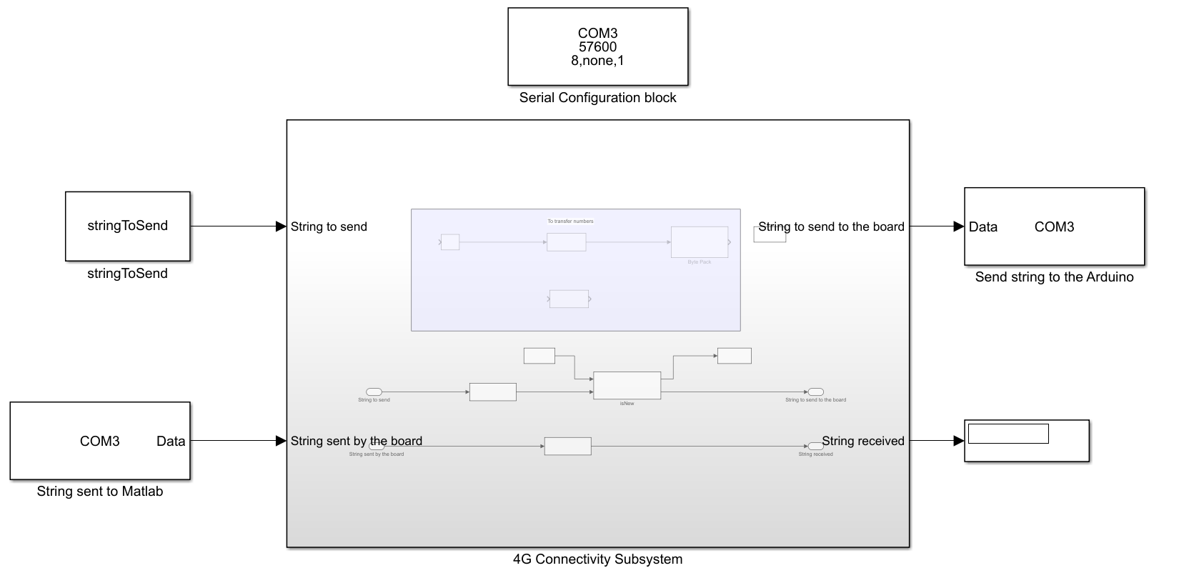

Implementation
Simulink module
Node-RED interface
Display the received messages
Easy sending of input messages
Arduino coding
Control the shield
Send data to Matlab and to servers
Process received data
Rapsberry Pi servers
MQTT server with topics
using Mosquitto
FTP server for the game
using VsFTPd

Slide 11
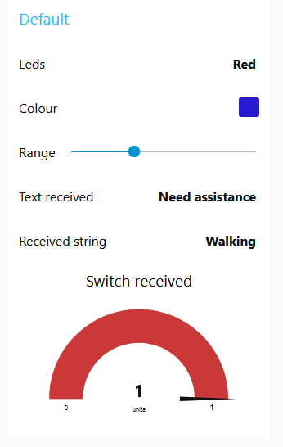
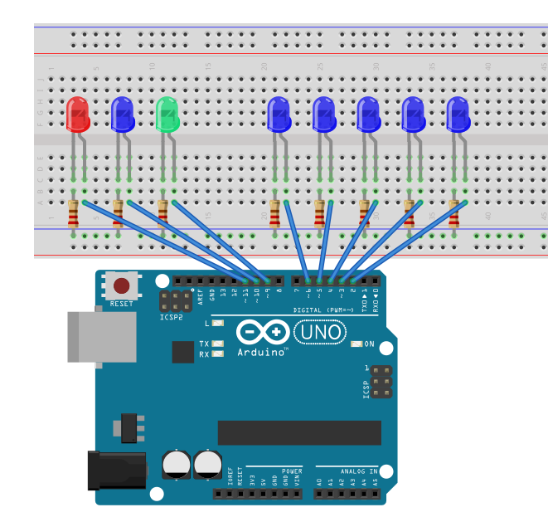
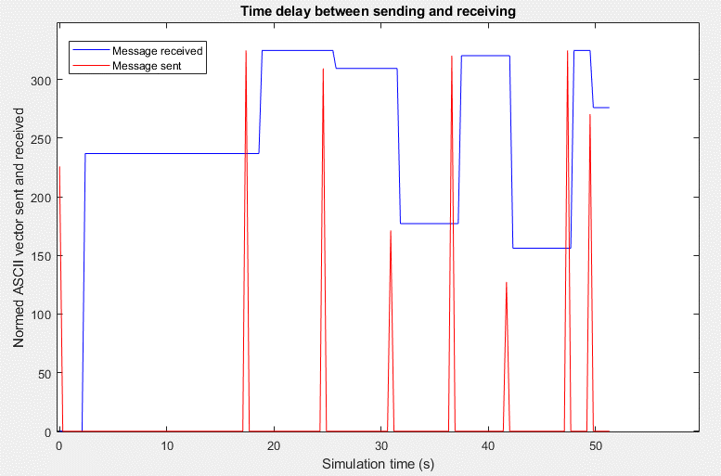
Separated results
Simulink subsystem able to send and receive strings and numbers
Monitoring of sending from Arduino
Testing of subscription by controlling LEDs
Everything is communicating reliably with low delay

Slide 12
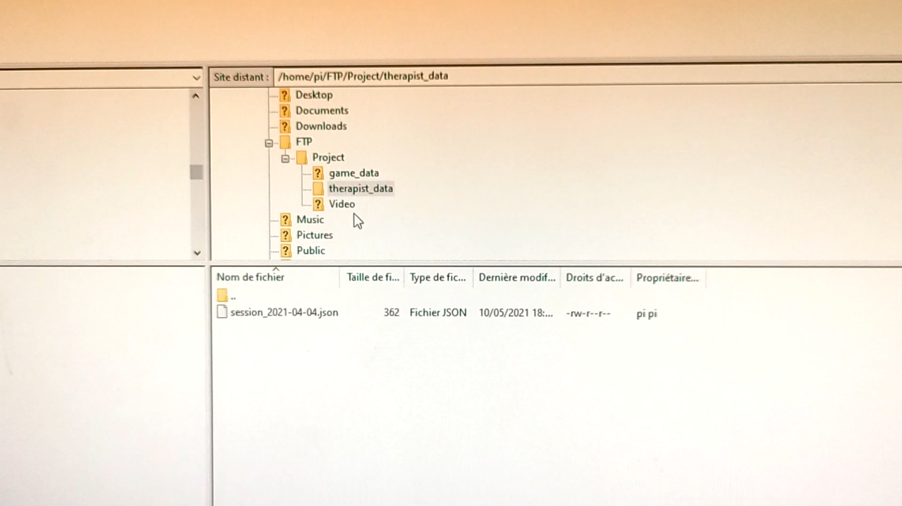
FTP Results

Slide 13
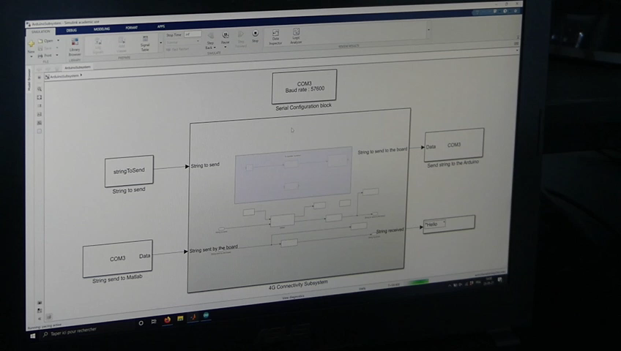
Final Results

Slide 14
Conclusion
Aim → reliable cellular communication exoskeleton-doctor
MQTT and LTE Cat 4 preferred
DFRobot SIM7600 Arduino shield chosen
Simulink module, Arduino, MQTT/FTP servers and monitoring interface implemented
After testing, functional IoT enabling system
Average latency of 200-300 ms from Matlab to MQTT server
Low latency for reception from the server
Future works:
Full interface built from scratch
Final connection between exoskeleton and 4G system missing

Slide 15

Q&A

Slide 17


Human mobility

Slide 18
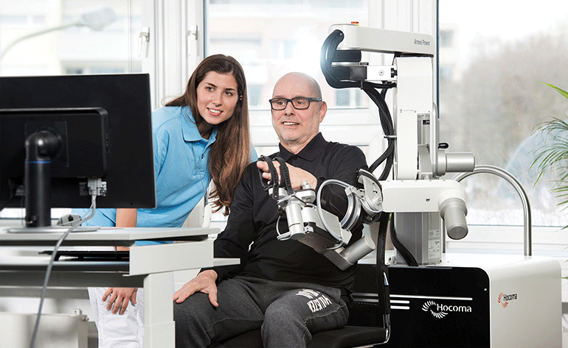
Solution
BICS exoskeleton for helping lifting loads
Hocoma ArmeoPower exoskeleton for stroke rehabilitation

Slide 19
Research questions
What are the main differences between the different mobile connectivity?
Which technology is best suited for current application in Belgium?
What connectivity module are best suited for remote control and monitoring?
How does the cellular connectivity work?

Slide 20

Project description
Link to several projects
Rehabilitation game
Need of monitoring for the doctors
Need of mobility
Connect the exoskeleton to the Internet
Cellular solution is needed:
To ensure connection everywhere
To avoid overloading of the local WiFi network
With a cloud for monitoring

Slide 21
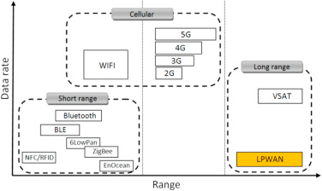
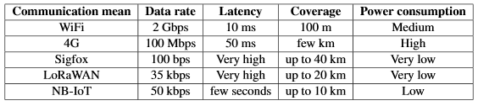
Communication means

Slide 22
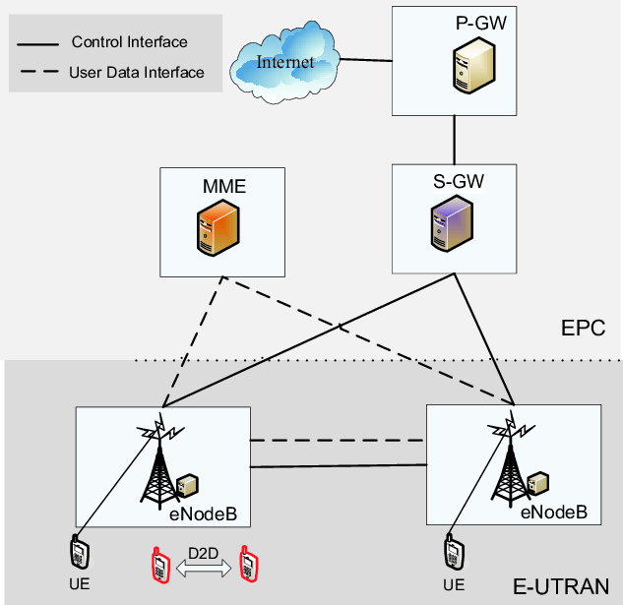
4G - LTE
eNodeBs: evolved base stations
Mobility management entity: Choose the right path
Serving Gateway: Gives the data to the PGW or to the user
Packet Gateway:
Entering gate between the operator IP and Internet
Frequency from 700 MHz to 3GHz
Round trip latency around 20ms
Around 100-300Mbps

Slide 23
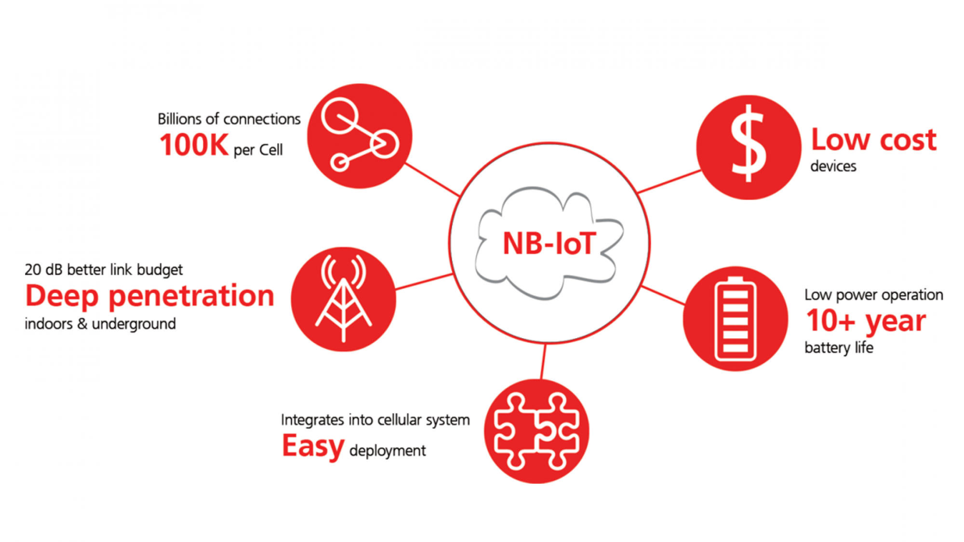
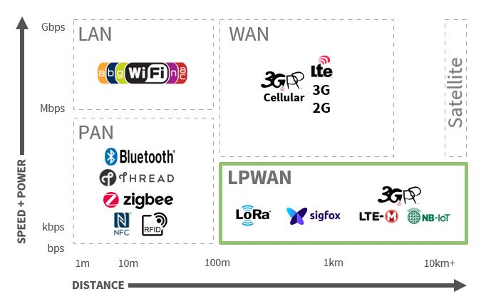
NB-IoT
Latency < 10s
25kbps
LPWAN in the 200kHz frequency range
No mobility
Bigger rate than Sigfox or LoRaWAN

Slide 24
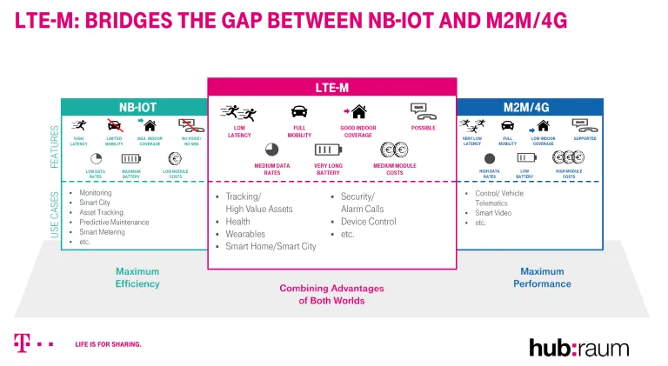
LTE-M, NB-IoT and LTE
NB-IoT:
Power efficient
High latency
Low data rate
No mobility
LTE-M:
Power efficient
Low latency
Medium data rate
Mobile
4G:
Low latency
High data rate
Mobile

Slide 25
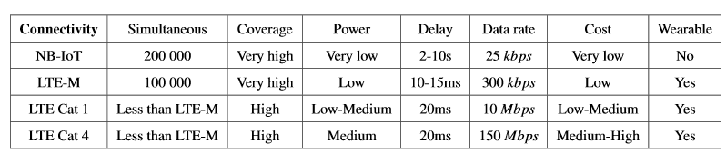
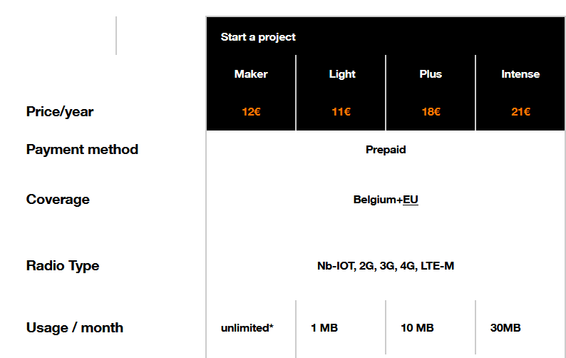
Comparaison of solutions
With 300kpbs
30MB reached in 13 minutes
Best choice: LTE-M but only one network provider in Belgium (Orange)
Regular LTE needed

Slide 26
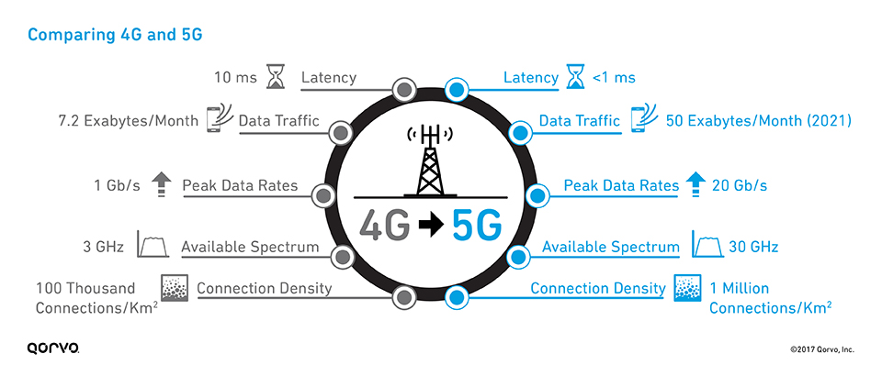
4G vs 5G

Slide 27
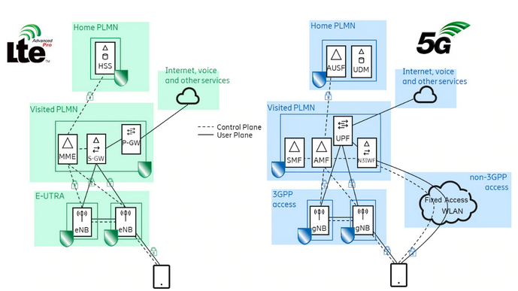
4G vs 5G

Slide 28
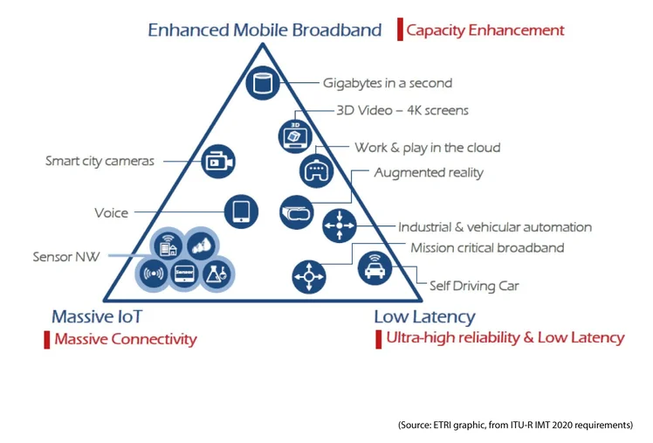
5G
From 3kHz to 300GHz
Low frequency → Longer distance
Data rates up to 20Gbps
Not broadly implemented yet

Slide 29
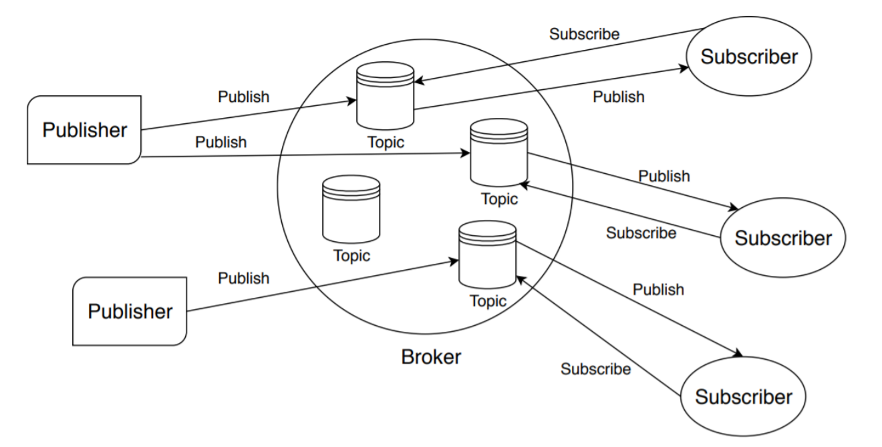
MQTT

Slide 30
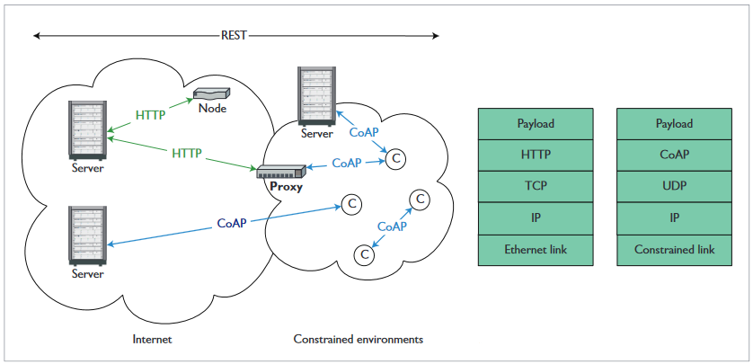
CoAP

Slide 31
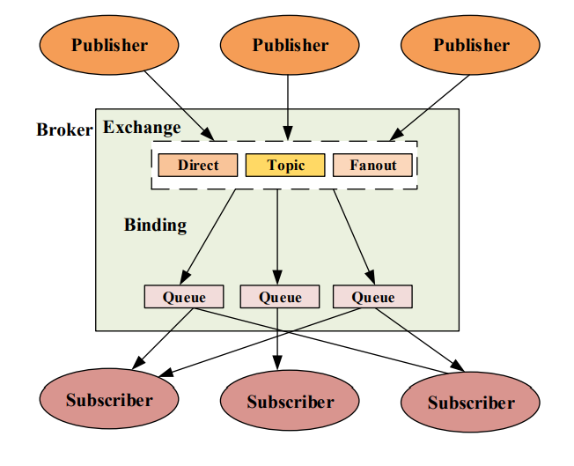
AMQP

Slide 32
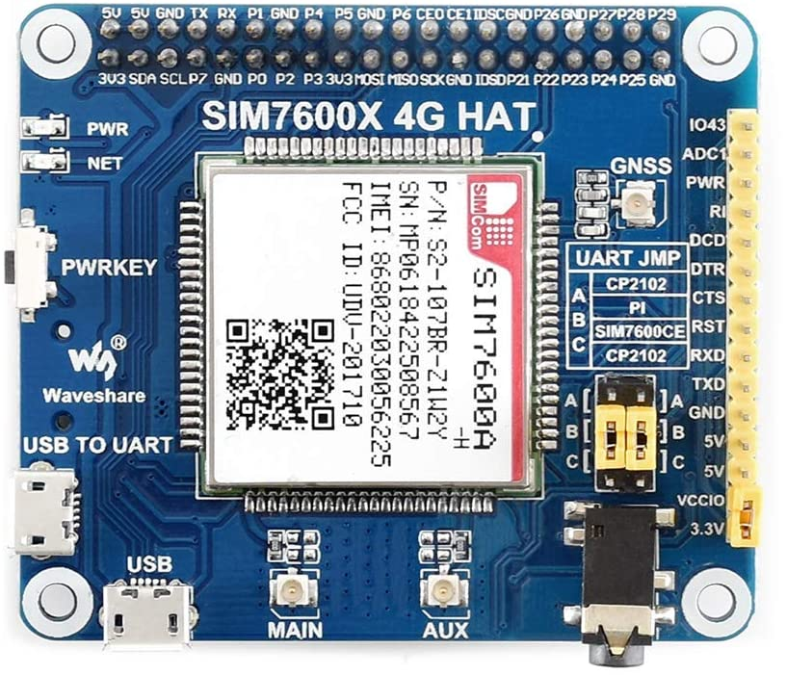
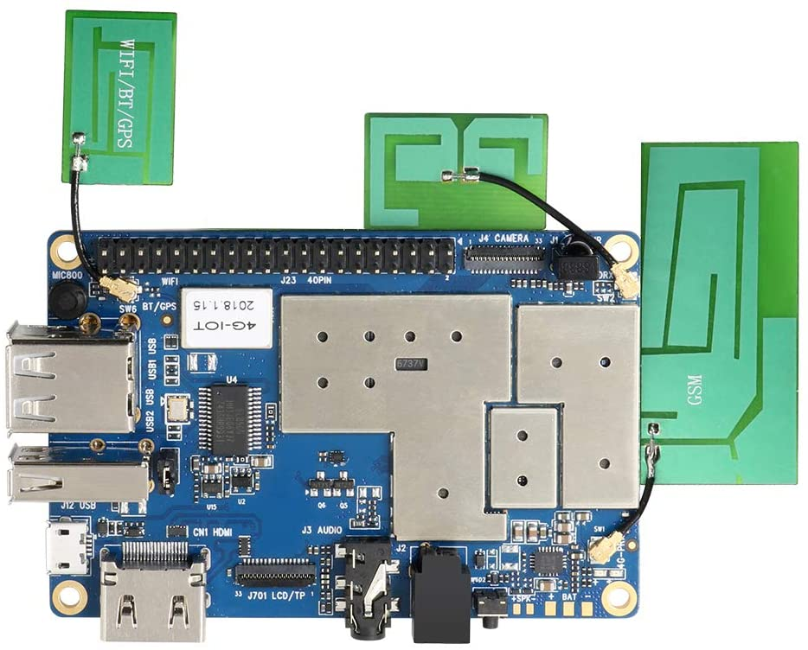
4G boards with MQTT
SIM7600 arduino shield
SIM7600 Raspberry Pi shield
Orange Pi 4G IoT
Easy Matlab implementation and coding
Arduino shield preferred

Slide 33
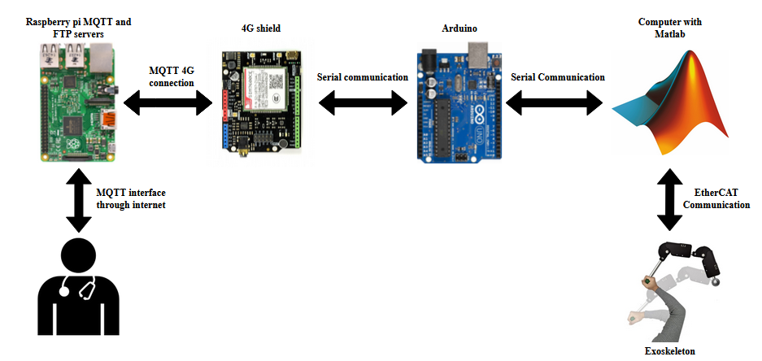
Project architecture

Slide 34
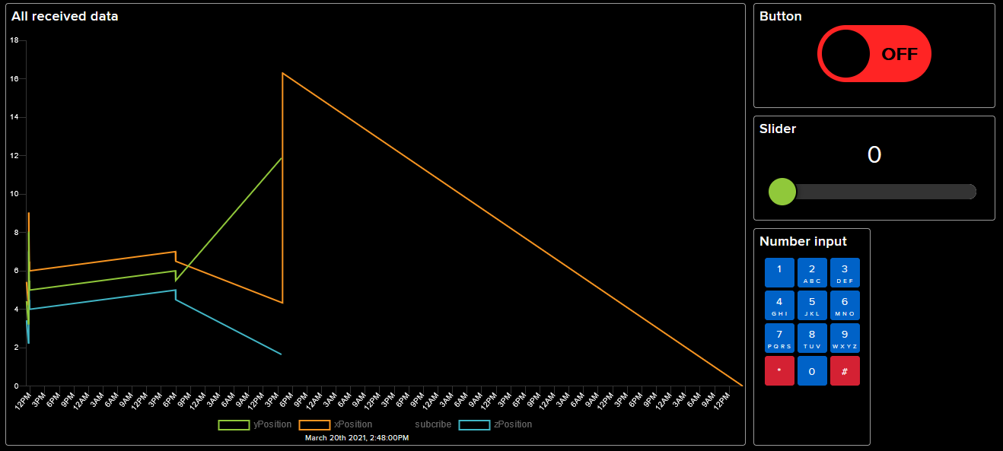
Adafruit - IO

Slide 35
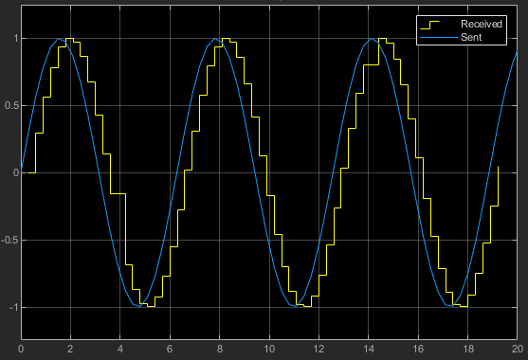
Matlab results

Slide 36
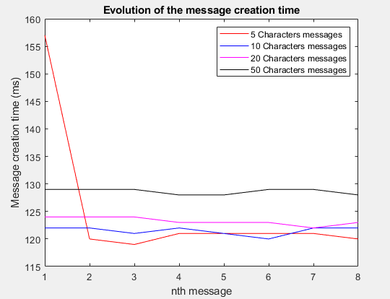
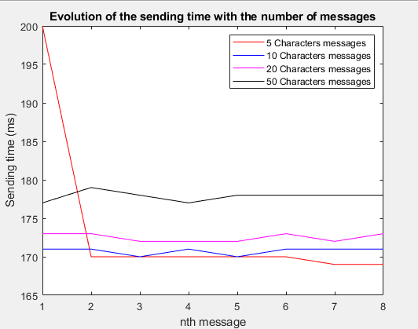
MQTT sending results
Node-RED interface
Sending time
But creation time = 120ms
More testing needed

Slide 37
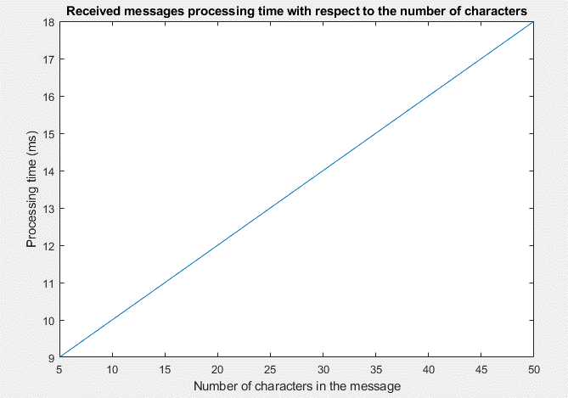
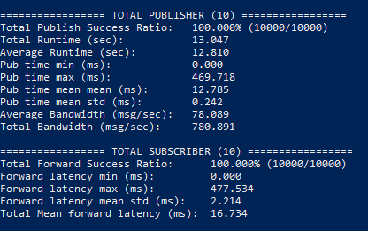
MQTT subscription and latency results
LEDs turn on and off with low delay
Processing time
Server latency
Total server latency of 16.7 ms and 12.7ms
Average delay of 10 ms for 10 characters

Slide 38
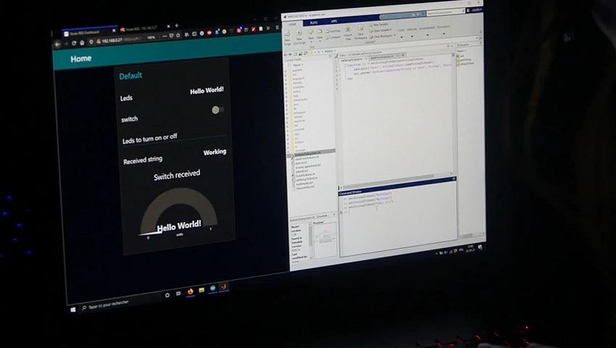
Final results

Slide 39
Final results

